Slide 1
Decision Tree
The decision tree algorithm tries to solve the problem, by using tree representation. Each internal node of the tree corresponds to an attribute, and each leaf node corresponds to a class label.

Slide 2
Decision Tree Algorithm Pseudocode
Place the best attribute of the dataset at the root of the tree.
Split the training set into subsets. Subsets should be made in such a way that each subset contains data with the same value for an attribute.
Repeat step 1 and step 2 on each subset until you find leaf nodes in all the branches of the tree.

Slide 3
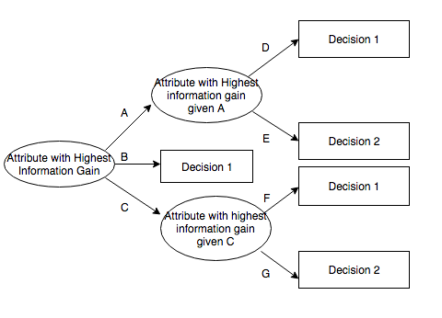
ID3 Algorithm

Slide 4
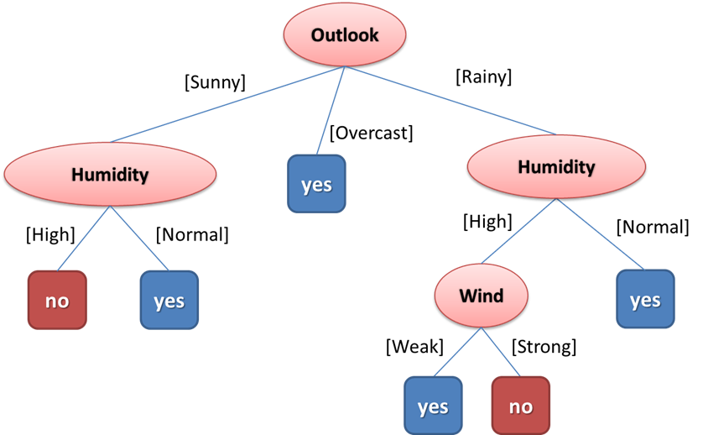
DECISION TREE REPRESENTATION
Example: PLAY TENNIS
(Outlook =Sunny ,Humidity =High)=>(Play Tennis = No)

Slide 5
ATTRIBUTE SELECTION
The popular attribute selection measures:
1.Information gain
2.Gini index
To measure the randomness or uncertainty of a random variable X is defined by Entropy.
Gini Index is a metric to measure how often a randomly chosen element would be incorrectly identified.

Slide 6
Advantages and Disadvantages
Advantages:
Decision Trees are easy to explain
It follows the same approach as humans generally follow while making decisions.
Even a naive person can understand logic.
Disadvantages:
Overfitting
Low prediction accuracy for a dataset
Handling with missing attributes
Calculations can become complex when there are many class labels.

Slide 7
